Slide 1

Trend Micro and The Financial Industry
You’re Not Alone!
Notes:
Customer: Seventh largest bank in Turkey.
Major Challenge: Adhering to PCI DSS, compliance with GDPR
conventional security wasn’t enough to detect/stop unknown and zero-day threats.
Why Trend Micro: Solutions automate many routine procedures and operations and help with compliance issues.
Solutions: Bank deployed Deep Security to protect its servers preventing data breaches and business disruptions while enabling compliance.
Results: Bank keeps its systems and customer data compliant with ever-changing regulations and protected from both known and zero-day threats.
With banks continuing to be targets for cyberattacks, Trend Micro continues to be a strategic partner of the bank.
When it comes to other industrial segments Trend Micro has detected more than billions of attacks between 2016 and 2019.

Slide 2
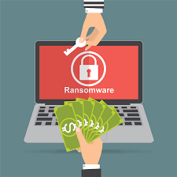
Protecting Against Ransomware
Understanding security controls
Known vs Unknown vulnerabilities
Defense in Depth
Notes:
Understanding security controls: The latest and expensive security controls might not necessarily fit all of your security objectives. Additionally, you might be still lacking visibility of your whole network environment.
*Note that a Next Generation firewall is just a first line of defense. if the firewall never detected the malicious network traffic, the ransomware would have spread out well before the endpoint security could help protect. That is why you need tools such as IDS and IPS to do a deeper layer of inspection to identify and block malicious events.
Known vs unknown vulnerabilities: There are still undocumented attacks that arise from unknown weakness systems that can be exploited. It is becoming increasingly common for servers to get hit with ransomware, as attackers are injecting it into known software vulnerabilities.
Defense in Depth: The ability to detect advanced malware, malicious behavior, and communications that are invisible to standard defenses is critical and requires the use of multiple, layered techniques. These techniques include anti malware, network security controls such as firewall, IPS, behavioural analysis and so on.
Protect your servers, whether physical, virtual, or in the cloud with Trend Micro™ Deep Security™.

Slide 3

Smart Protection Network
Provides up-to-the second threat intelligence
Notes:
How do we secure your environment?
Smart Protection Network: mines data across the globe to ensure up-to-the-second (quick) threat intelligence to immediately stamp out attacks before they can harm valuable enterprise data assets.
Deep Security takes advantage of Trend Micro Smart Protection Network to deliver:
Real-time updates of malware signatures and patterns.
Protection from emerging threats by continuously evaluating and correlating threat and reputation intelligence for websites, email sources, and files.
Customers’ protection is automatically updated and strengthened as more products, services and users access the network, creating a real-time neighborhood watch protection service for its users.

Slide 4
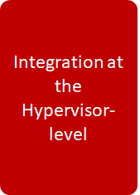
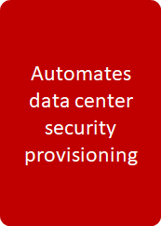
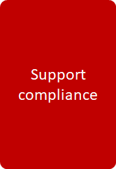
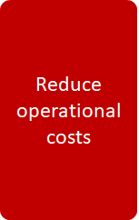
Deep Security as a Solution
Notes:
Deep Security takes a better approach to virtualization security with integration at the hypervisor-level through VMware NSX. Automatically deployed with no downtime, it removes the need to install and manage a separate agent on every virtual machine
Virtual machines are protected the moment they are provisioned, it recommends and applies only the policies that are relevant.
Detailed, auditable reports that document prevented vulnerabilities, detected attacks, and policy compliance status. Reduces preparation time and effort required to support audits.
The integrated administrative console gives you single, up-to-date view of security posture of your entire environment, reducing time and operation costs by making security management more efficient.
My link:
https://docs.google.com/document/d/14esoae2wX3yK2m1x8tqzvUJUbUcB5JvJANEamJJHiIs/edit?usp=sharing

Slide 5
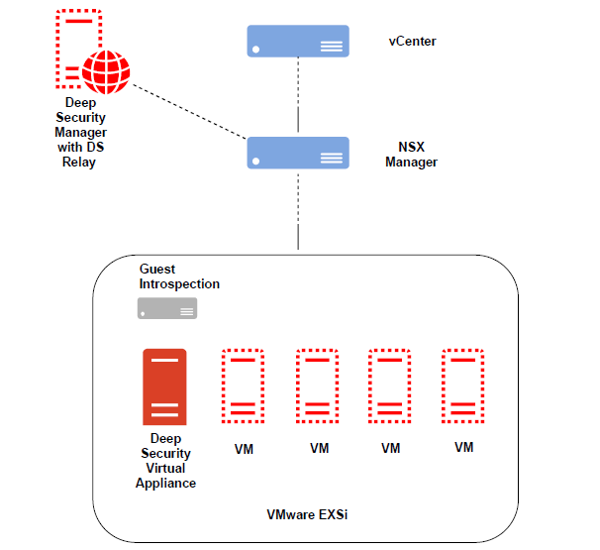
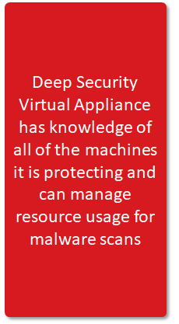
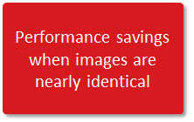
Seamless Integration with VMware
Notes:
The Trend Micro Deep Security Virtual Appliance (DSVA) protects virtual machines (VMs) running on your VMware ESXi servers through VMware NSX Manager. Any new hosts added to the cluster automatically get Deep Security protection.
DSVA’s capability of Scan Caching helps performance savings for nearly identical images. It manages resource usage and prevents scan storms.
Scan Storms: An Anti-Malware scan storm is the demand on computing resources that occurs when antivirus software simultaneously scans multiple guest virtual machines on a single physical host. The result is degradation of service.
NSX 6.2.4 version (vShield Endpoint) or NSX Standard allows customers to use agentless protection (free of cost) through Deep Security for Anti-Malware and Integrity Monitoring; Customers must use a Deep Security Agent (combined mode) if they want to have Firewall, Intrusion Prevention, Web Reputation, Application Control and Log Inspection capabilities.
Automating VM discovery and security deployment on vSphere: Through deep integration with vCenter, our approach enables IT teams to query and monitor the security state of managed virtual machines. With full visibility, organisations can easily create and manage security policies, get alerts, and take preventive actions to protect the data centre.
ESX Scanning De-Duplication
Files scanned on VMs will be cached and shared across the entire ESX/ESXi reducing access time and most importantly the duration of On-Demand Scans
Through the integration with VMware NSX, Deep Security Virtual Appliances can perform agentless Firewall, Intrusion Prevention, Anti-Malware (Windows only) and Integrity Monitoring capabilities (Windows only) to each of the protected virtual machines. If additional features and/or platforms are required in the implementation, an on-virtual-host Deep Security Agent can be installed.

Slide 6
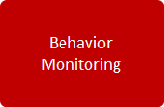

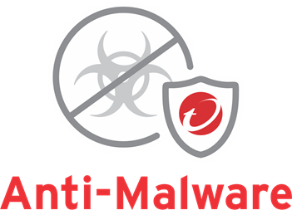
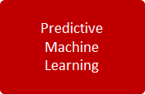
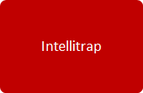
More than just an Anti-Malware
Notes:
Notes:
Anti-Malware - detects and blocks malicious software such as viruses, trojans, spyware, ransomware and other applications intended to harm endpoints
On top of virus, spyware, grayware scanning capabilities our anti-malware module provides protection against more sophisticated and targeted attacks.
In Behavior Monitoring, the extended ransomware protection feature can protect documents against unauthorized encryption or modification.
In Process Memory scanning, DS monitors process memory in real time and can be set to terminate the running processes if found suspicious.
For Predictive Machine Learning, DS extract file features and sends to the Trend Micro Smart Protection Network; the sample is then compared to the malware model, assigned a probability score (depending on the severity) and probable malware type is determined.
Really cool feature! Intellitrap is available for Real-Time Scanning. It blocks real-time compressed executable files which can be quarantined to determine the security risks.

Slide 7
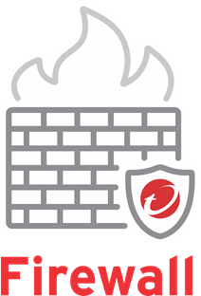

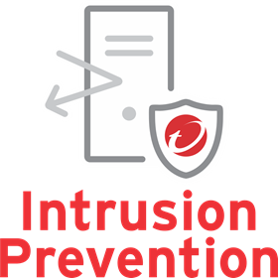
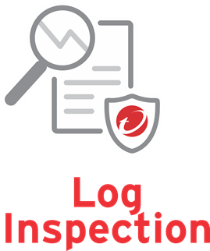


Other Security Controls
https://drive.google.com/file/d/0B4yuFwUjNL1MVkc1V1FSdHF0clBDTXl0WkZfMTFKdlYwaVFV/view
Notes:
Notes:
Firewall - provides broad coverage for all IP-based protocols and frame types as well as fine-grained filtering for ports and IP and MAC addresses through a bidirectional, stateful firewall.
ESX Scanning Deduplication
Files scanned on VMs will be cached and shared across the entire ESX/ESXi reducing access time and most importantly the duration of On-Demand Scans
Intrusion Prevention - examines all incoming and outcoming traffic at the packet level, and can be used for virtual patching, protocol hygiene, and application control
Virtual Patching
Drops traffic attempting to leverage unpatched vulnerabilities in applications or the operating system. This keeps servers and endpoints protected until relevant patches can be applied
Integrity Monitoring - monitors critical operating system and application files, including directories, custom files, registry keys and values, open ports, processes and services to provide real-time detection and reporting of malicious and unexpected changes.
Web Reputation - tracks credibility of websites and safeguards servers from malicious URLs, or when an application makes an internal reference to a URL
Log Inspection - collects and analyzes operating system and application logs for suspicious behavior, security events, and administrative events across the data center
Log inspection requires running some analysis on the computer and as a result, it is not supported in agentless deployments
Application Control - monitors computers for any software changes that drift away from an approved software inventory. Application control is not supported in agentless deployments.
** Log Inspection and Application Control are not supported in agentless deployments due to hardware requirements **

Slide 8


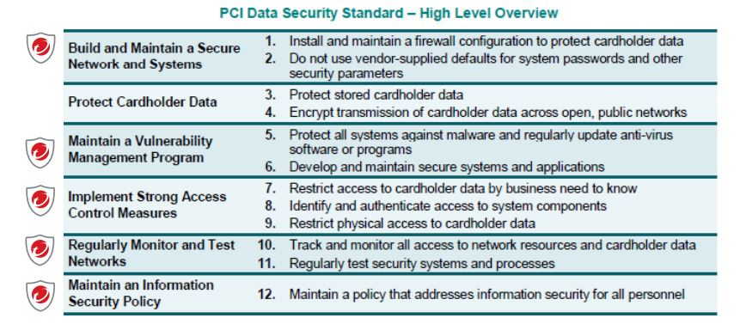
Compliance
Notes:
Deep Security is capable of supporting PCI and GDPR compliance by using the same basic principles due this being in the banking sector.
Has achieved this before within 3 months.
Uses TLS 1.2
GDPR: “We have appointed a data protection officer (DPO) for Europe and have a GDPR support team to ensure that our privacy processes and procedures continue to be consistent with data protection regulations.”
PCI: You can achieve PCI compliance up to 4 times* faster and simplify security management by addressing many PCI requirements with a single offering. (Coiney&MatchMove Success Stories)

Slide 9
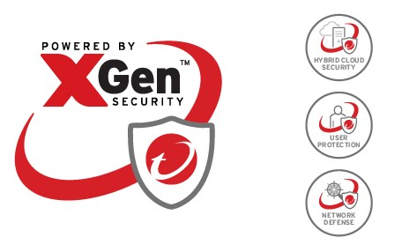


More than Just a Cyber Security Company
Notes:
Connected Threat Defense- To best defend your organization Trend Micro’s Solutions works seamlessly together as a part of a system, automatically sharing threat intelligence across security layers with centralized visibility and control across the entire system to speed time to protect, detect and respond. A truly smart, optimized Connected Threat Defense.
Trend Forward Capital - “We seek out long-term relationships that allow us to amplify what companies are already doing well, while learning from them in the process.”
At CES 2020, Trend Forward Capital will be awarding a total of $30,000 to three startups.
Zero Day Initiative - the world's largest vendor-agnostic bug bounty program. (Virtual Patching)

Slide 10
References
Trend Micro Help Center
https://help.deepsecurity.trendmicro.com/
Compliance
https://help.deepsecurity.trendmicro.com/pci-compliancy.html?Highlight=compliance
Ransomware
https://www.trendmicro.com/en_us/business/capabilities/solutions-for/ransomware.html
https://blog.trendmicro.com/where-will-ransomware-go-in-the-second-half-of-2019/
Customer Stories
https://www.trendmicro.com/en_se/about/customer-stories.html
Zero Day Initiative
https://www.zerodayinitiative.com/about/
Trend Forward
https://www.trendforward.com/index.html

